Slide 1
INFO1112 Tutorial
Week 4

Slide 2

Couple of reminders
Homework 2 – due Sunday 27th August 23:59:00
Remember, solving the testcases grants you only 50%, you must attend a homework interview following the submission to make you eligible for full marks
Assignment 1 – due Sunday 3rd September 23:59:00 (Week 5)
Any questions, refer to Edstem if there is a question you have it is very likely another student has asked it already. If not, there may be something in the assignment specs that clarify the answer

Slide 3
Assignment Reminder + FAQs
Having trouble with test case(s)
If public – name will often give a clue at what the test case is testing
Otherwise:
Ensure your program covers all required specifications
Try to figure out how to break your own code
Remember, passing public test cases doesn’t guarantee full marks for functionality
Extra, non-public tests will be used later
That’s why we encourage you to create your own tests :)

Slide 4
Homework stuff
Homework 1 – interviews to be finished up today
Short, brief interviews to ensure you can understand
commands
flags
what would happen if we changed some aspect of your script
Can look at your code whilst doing the interview

Slide 5
Brief summary of this week’s content

Slide 6

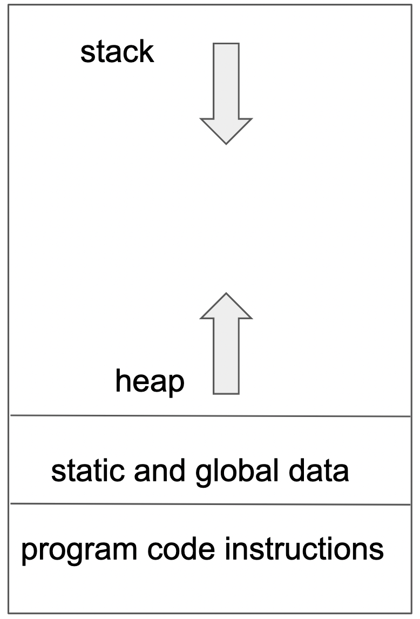

4.1 – Memory Management
Memory for processes is stored in the following layout:
program code instructions: at bottom of program
static and global data
data available to the whole program
constants often included here
heap – used to store data structures, often objects in object-oriented code
grows upwards to expand
stack – used to store temporary variables – e.g. variables which are used within a function, or function arguments
often discarded when not needed
grows downwards to expand
address 0

Slide 7
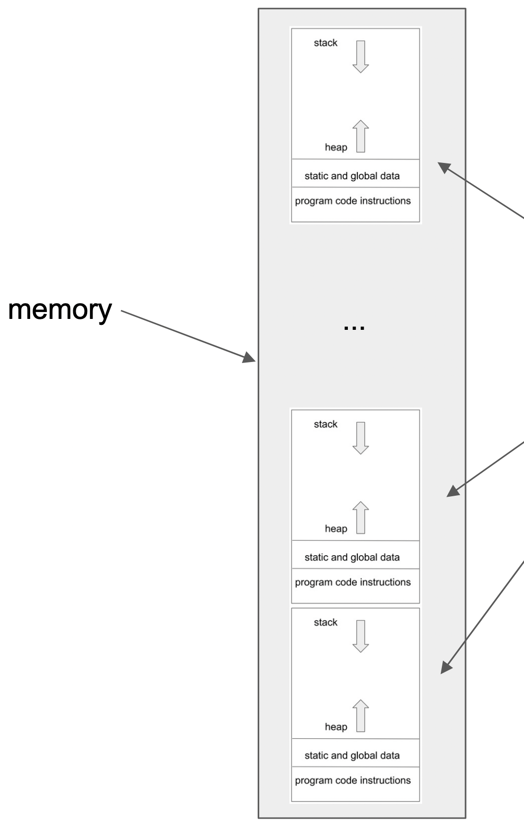
4.1 – Memory Management
For the entire computer, the memory for processes is laid out similar to the diagram
But how can each process be at address 0?
Originally, utilised mapping – CPU remaps relative addresses of processes to actual address in memory
Nowadays, layout of memory for processes is more complicated and can be both stored in RAM and on mass storage, and overlap
How memory is stored per process is laid out in page table

Slide 8
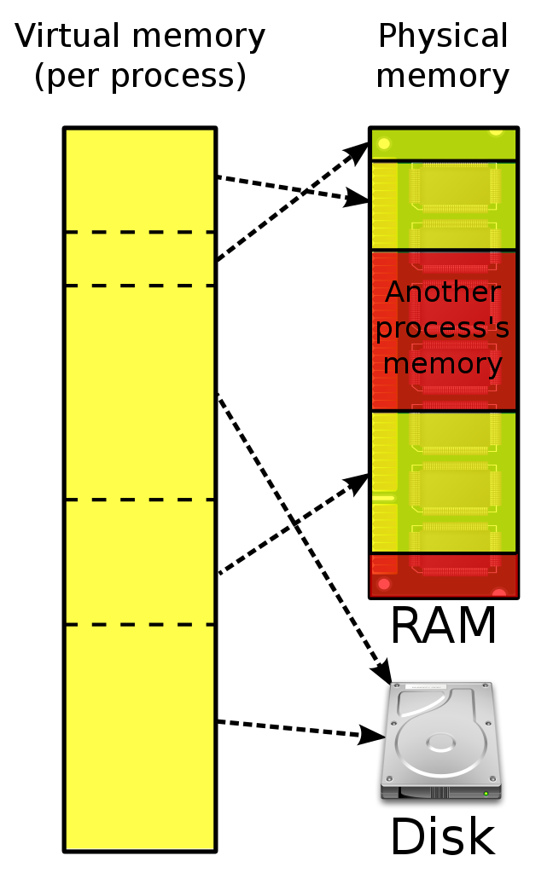
4.1 – Memory Management
Each process is allocated virtual memory
The process sees this as a regular, contiguous memory block
In reality, the OS maps different parts of this memory to the different locations of RAM/mass storage in which they are stored, as in the diagram
Why use mass storage for memory?
RAM has more limited size than hard drives
If some memory required by the program won’t be accessed/changed much, it makes sense to temporarily store it in mass storage
Benefits of virtual memory
If process memory needs to be expanded, the page table entry for the process can be adjusted to account for extra memory

Slide 9
4.1 – Memory Management
What happens if a process needs to access memory on mass storage?
Request for access will throw an interrupt to OS kernel – essentially telling CPU to save what it’s doing and handle this request
Kernel finds section on disk, and writes it to free area of RAM
If there is no free RAM left, the kernel must take some existing block of memory from a process in the RAM, and swap it to mass storage
Page table updated to account for this changes
Handy features of virtual memory
“shared memory” – processes can have parts of their memory mapped to the same physical block
“copy on write” – when a process is forked, both parent and child share the same memory, until it needs to be changed
Find info about virtual and “real” memory of a process
In ps:
the VSZ field tells us about the size of the process’s virtual memory
the RSS field tells us about how much physical RAM a process is using

Slide 10
4.2 – Scheduling
From experience with ps, we can see a system has many processes in memory at one time
However, a single CPU system can only execute one process at a time – during this time, other processes are sleeping, and can be
waiting for resource (e.g. file, I/O device) to become available
waiting to be executed by CPU
Each process eventually gets a turn to be executed by the CPU through scheduling – creating ordered queue for processes to run

Slide 11
4.2 – Scheduling
First type of scheduling: round robin (each process has even run time on CPU)
Modern scheduling takes into account a priority for each process
Range from negative integers (highest priority) to positive integers (lowest priority)
On Linux, by default, the priority for processes started by users is 20
Priority of process can be altered by changing its nice value
nice value adds/subtracts a number to a process’s priority to modify its default priority
nice value is separate from the priority itself

Slide 12
4.2 – Scheduling
nice command allows for a program to run with a specified nice value (with -n flag)
e.g. $ nice -n 5 sleep 30
To modify a currently running process’s nice value, use the renice command with the process’s PID
e.g. $ renice 10 -p 1203
Valid nice values typically range from -20 (highest priority) to 19 (lowest priority).
Default value is 0 (has a neutral priority)

Slide 13
4.2 – Scheduling
Managing process in the background (started with &, e.g. $ sleep 30 &)
To suspend a currently running process, press Ctrl+Z
List of processed managed by the shell (including suspended, background processes) shown by jobs command
[1] running sleep 120
[2] + suspended sleep 30
[3] - running sleep 120
gives job number for each process
With job number, a job can be sent to:
background with bg command: e.g. $ bg 2
foreground with fg command; e.g. $ fg 3
A suspended process will start running if bg or fg is used
Zsh (default macOS shell) quirk: bg and fg won’t work with just the job number, you need to put a % in front of the job number
e.g. $ bg %2

Slide 14
4.3 – Boot Sequence
Sequence of steps required to boot the operating system
Computer hardware does some test operations to make sure everything is in working order, and nothing will fry the machine:
all hardware works properly
CPU cooler is attached properly
System reads read-only memory (ROM) at first address for instruction starting up the computer
First address contains jump instruction that transfers control to code in ROM to continue booting:
more hardware checks are performed
finds what devices are connected (e.g. hard drives)

Slide 15
4.3 – Boot Sequence
Code in ROM then works out where to find next stage of boot sequence, loads this in memory, and jumps to these instructions
Older systems: BIOS (Basic I/O System) provides a fixed list of places of where to continue booting
Modern systems use UEFI (Universal Extendable Firmware Interface) – effectively works the same as BIOS, but with more features, and stores data about OS initialisation in EFI System Partition (ESP) on hard disk
Both BIOS and UEFI provide location on where to continue booting computer
BIOS points to Master Boot Record (MBR) of hard drive
UEFI points to ESP on hard drive

Slide 16
4.3 – Boot Sequence
Computer looks inside MBR (for BIOS systems) or ESP (for UEFI systems) for bootloader
Both are located at the beginning of a disk – with ESP specifically being a regular partition (the first one)
Bootloader is used to begin the process of using operating systems
Linux systems often use GRand Unified Bootloader (GRUB)
Contains drivers which can read file systems on mass storage devices
Bootloader finds OS kernel file in boot partition, and loads this to start up the OS
Often located in /boot folder on Linux systems
Multiple kernels can exist – bootloader decides which one to load
Kernel performs high-level hardware checks, loads device drivers, and mounts needed file systems (on Linux, this is given by the /etc/fstab file)

Slide 17
4.3 – Boot Sequence
Kernel begins starting processes
First process that is started is program called init
Given PID of 1
Starts all other system processes and daemons
All processes can trace ancestry back to init
Various modern implementations
Linux: systemd
macOS: launchd
OS is booted!

Slide 18

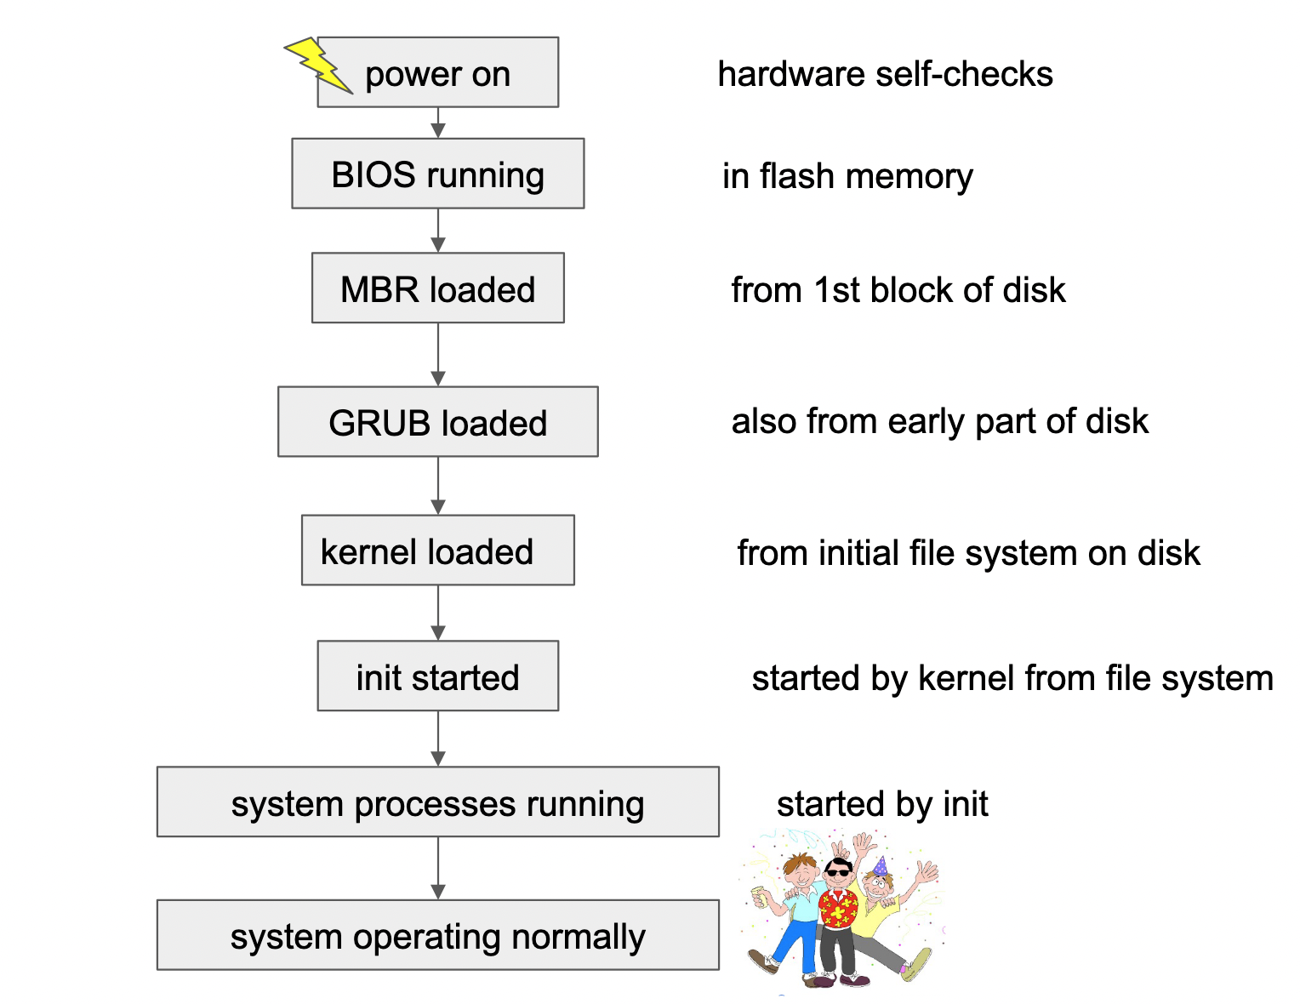

4.3 – Boot Sequence

Slide 19
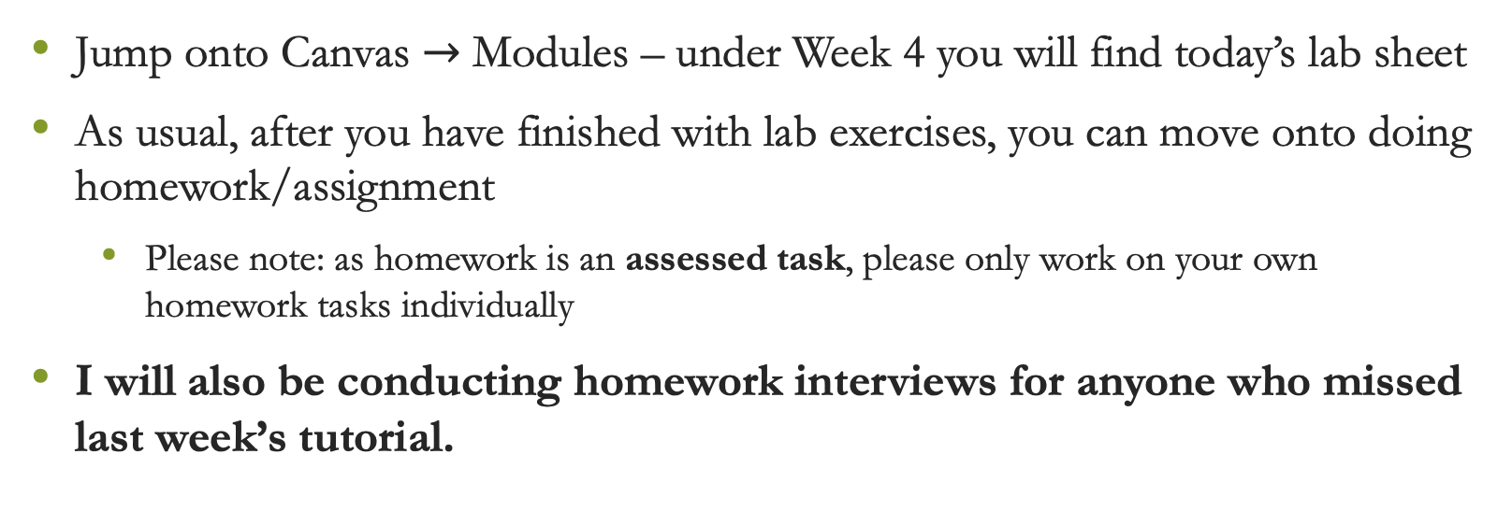
Lab exercises
Jump onto Canvas $→$ Modules – under Week 4 you will find today’s lab sheet
As usual, after you have finished with lab exercises, you can move onto doing homework/assignment
Please note: as homework is an assessed task, please only work on your own homework tasks individually
I will also be conducting homework interviews for anyone who missed last week’s tutorial.

Slide 20

Attendance
https://bit.ly/45iLDMu

